Slide 1
Bellabeat MARKETING STRATEGY
by Clarissa McCarthy

Slide 2
Agenda
01
02
03
04
05
06
Introductions
Project Overview & Goals
Data & Analysis
Recommendations
Actionable Steps
Questions

Slide 3
01
Introductions

Slide 4



Hello!
CLARISSA MCCARTHY - Lead Data Analyst
IBARA GRAFF - Data Visualization
CARPE DATUM - Data Cleaner

Slide 5
02
Project Overview & Goals

Slide 6

Using Fitness Device Trends to Guide Bellabeat Marketing
Bellabeat is in position to become a pillar in the global smart device market.
The goal of this project was to analyze trends in smart fitness device use to guide Bellabeat’s marketing strategy.
Our focus was on in-demand features to be updated and highlighted.

Slide 7
03
Data & Analysis

Slide 8
THREE DATA SOURCES
FitBit Tracking
Fitness Wearable Survey
Exercise Survey
Health tracking data from 30 FitBit users.
Activity, sleep, weight
Survey responses from 33 fitness wearable users regarding the impact of their device.
Effectiveness of features, length of ownership, demographics
Survey responses from 400+ people regarding their attitudes towards exercise.
Barriers to exercising, motivations

Slide 9
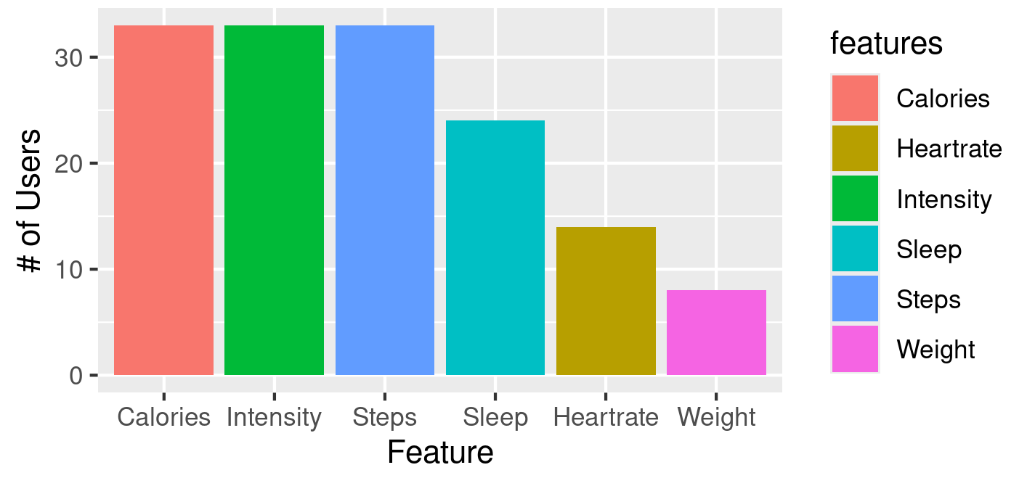
FitBit Feature Popularity
Notes:
Weight is least used feature - ineffective or unnecessary?
Sleep is also used less than other features

Slide 10
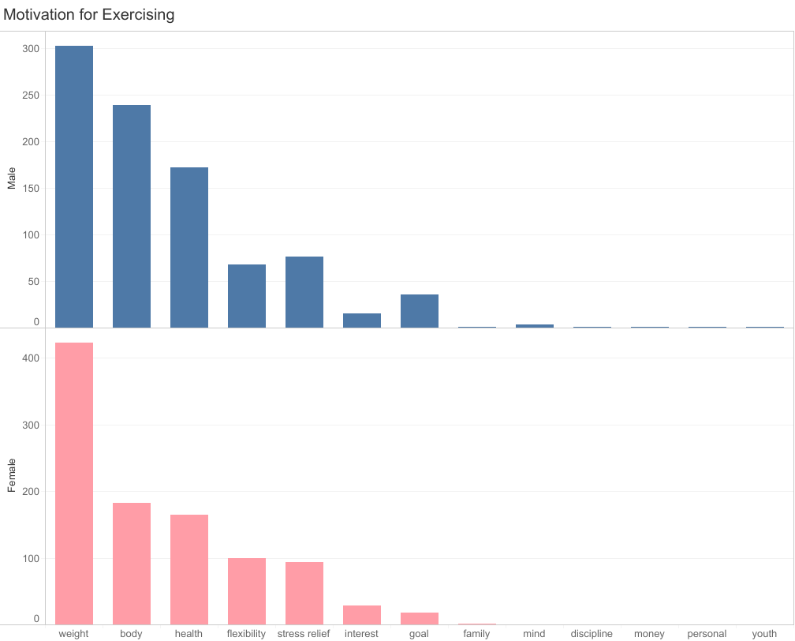
Motivations for Exercising
Top Motivators: weight loss (423) and body image (182)
Further Research:
Why is the popularity of FitBit’s weight feature so low?
Unnecessary? (unlikely)
Ineffective?
Poorly advertised?
Notes:
Ineffective - manual entry vs automatic?

Slide 11
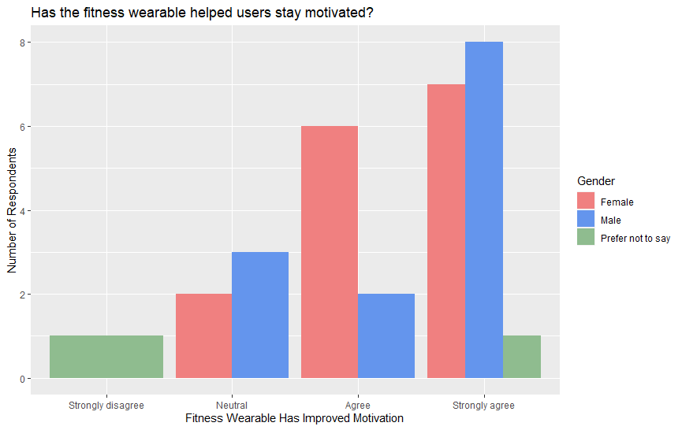
Impact on Motivation to Exercise
80% agree or strongly agree that their fitness wearable helps them stay motivated.
Trend is true for men and women.
Appears to be a market for weight tracking/ motivational features.

Slide 12
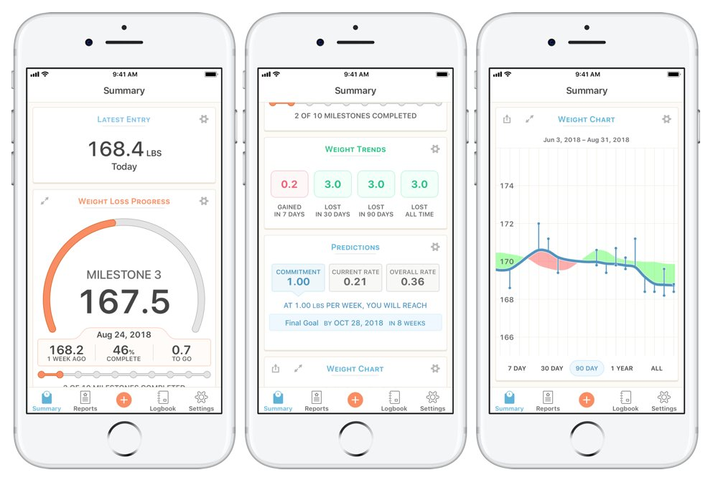
Further Research into Weight Feature
FitBit’s weight feature is its least popular feature.
But weight loss is the most popular motivation for exercising.
80% of fitness wearable users say their device helps keep them motivated to exercise.
Further Research:
Why is FitBit’s feature unsuccessful?
What do users want in a weight feature?

Slide 13
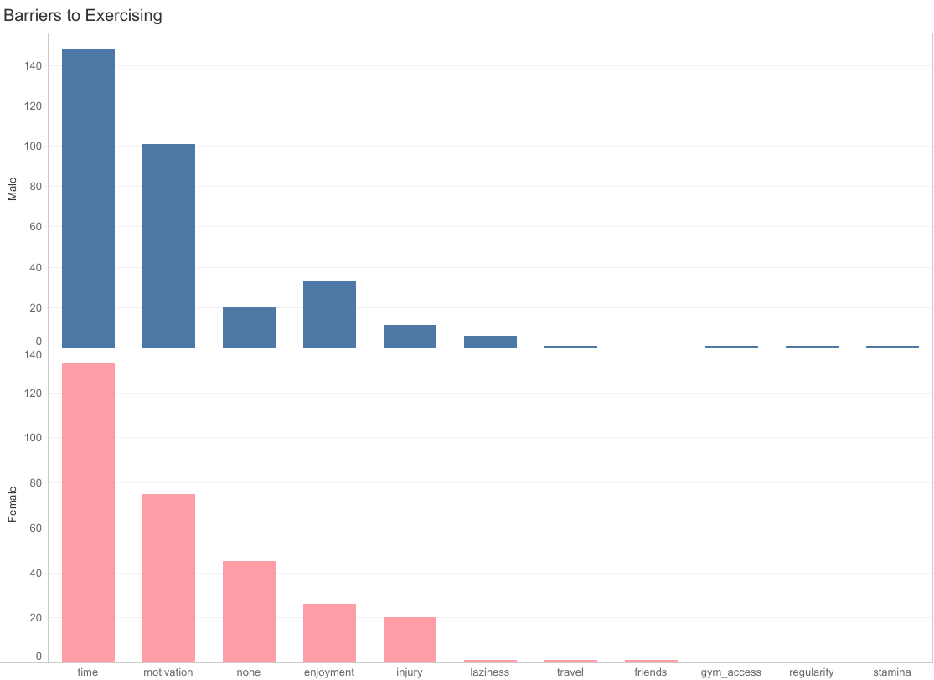
Barriers to Exercising
Top Barriers: time (133) and motivation (75)
Helping users overcome these barriers can increase sales and customer loyalty.
Fitness wearable users say their device helps them stay motivated.

Slide 14
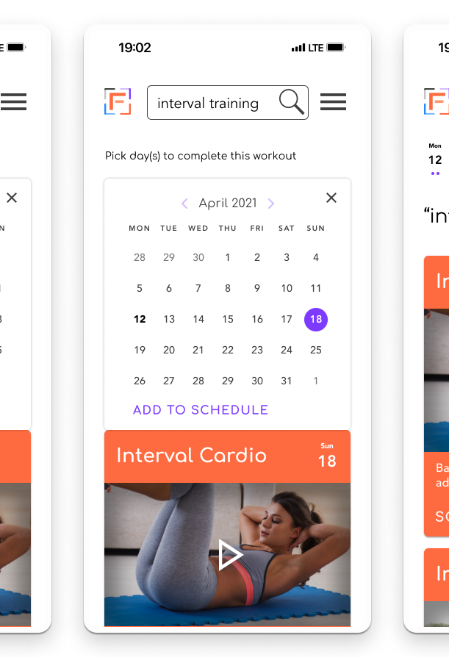
Overcoming Time and Motivational Barriers
Implement features that:
Help users fit exercising into their schedule.
Motivate users to continue exercising.
Example: an exercise scheduler with personalized reminders.
Notes:
Personalized reminder - user selects motivators; reminders before workout, after missing x workouts in a row, etc.

Slide 15
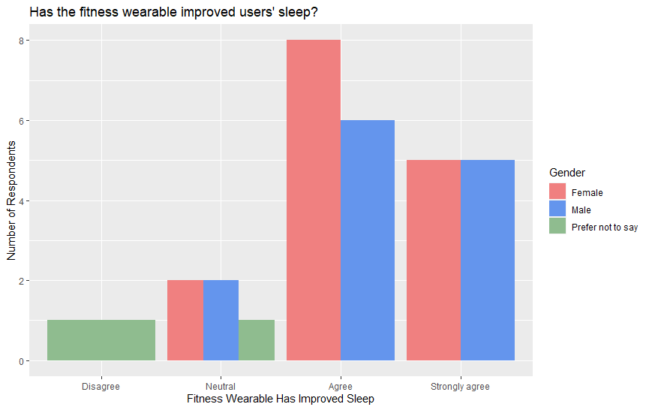
Effectiveness of Sleep Features
80% agree or strongly agree that their fitness wearable improves their sleep.
Trend is true for men and women.

Slide 16
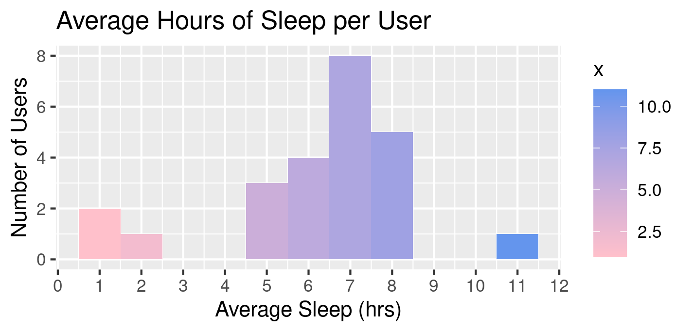
Average Sleep of FitBit Users
Recommended sleep is 7-9 hours.
Average sleep is 6.2 hours.
Most users get around 7 hours.
https://www.nhlbi.nih.gov/health/sleep/how-much-sleep#:~:text=Experts%20recommend%20that%20adults%20sleep,or%20more%20hours%20a%20night
Notes:
Cite National Institute of Health

Slide 17
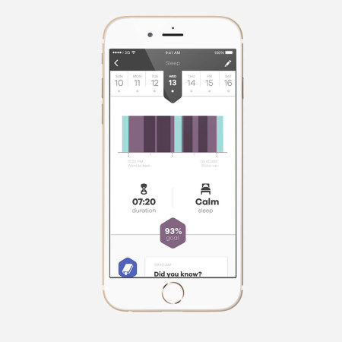
Bellabeat’s Sleep Feature
80% of fitness wearable users report an increase in sleep quality due to their device.
FitBit users average at the lower end of recommended sleep.
Further Research:
Compare with average sleep of Bellabeat customers.
If we’re better, highlight it!
If we’re the same or worse, research how we can improve.

Slide 18
04
Recommendations

Slide 19
Marketing In-Demand Features
Investigate Demand for Weight Tracking
Implement Scheduling Features
Highlight Sleep Features
Why is FitBit’s weight feature unpopular?
What do users want in a weight-tracking feature?
Help users overcome barriers to exercising.
Increase sales and customer loyalty.
Personalized reminders
Compare quality of sleep for Bellabeat customers vs FitBit.
Further research in improving sleep quality.

Slide 20
05
Actionable Steps

Slide 21
What’s Next?
Analyze FitBit Weight
Analyze Bellabeat Sleep
Analyze why FitBit’s weight feature is unpopular. Include survey data to know what users want from this feature.
Compare the sleep metrics of our customers with those of FitBit. If we’re better, highlight it! If not, analyze what we could change.
Implement Scheduling
Implement Personalized Reminders
Prompting users to set up a schedule for their workouts helps them overcome the time barrier.
Let users select what motivates them so their reminders can be as effective as possible! Keeping them motivated increases our sales and customer loyalty!

Slide 22
THANKS!
DO YOU HAVE ANY QUESTIONS?
clarissaissy05@gmail.com
https://clarissamc.github.io/MyWebsite

